Slide 1
Engaging Students With Augmented Reality
By Nora Strasser, Ed. D.
Friends University
Wichita, KS
Notes:
This presentation is on using augmented reality to engage students. What is augmented reality? When you use your smartphone to scan an image and a video pops up that overlays the real world. This has been used successfully in the Pokemon Go game. I used this with my Calculus 3 course. We were looking at the graphs of functions of two variable.

Slide 2
HP Reveal
Free to Download and Use
https://www.hpreveal.com/
Apps available for Apple and Android!
Notes:
I discovered an app called HP reveal. There are apps for both apple and android. You can also use a computer to create the augmented reality.

Slide 3
Creating Augmented reality (AURAS)
Take a photo or image that will act as the trigger photo. This photo needs to be unique enough that it can be recognized by the app.
Create a video (or still image) that will play when the trigger photo is scanned. These are called overlays.
Notes:
How did I create the augmented reality? First I created a trigger image. This can be a photograph or any other graphics file such as the graph of a function. Next, I have to create the video or (still image) that is called the overlay. We need to combine these together to create what is called an aura.

Slide 4
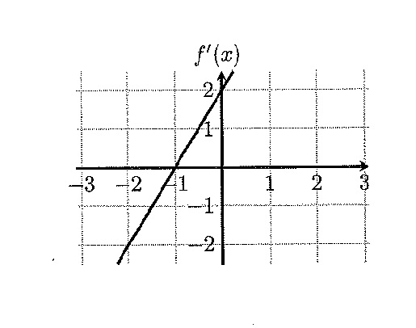
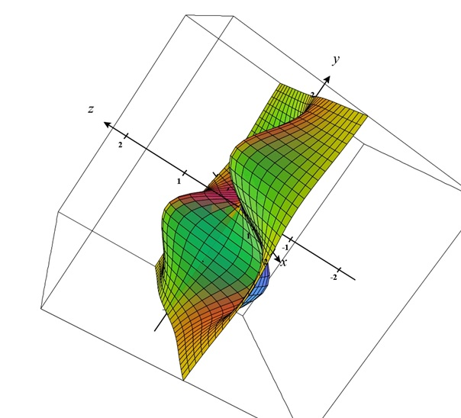
Trigger Photo Characteristics
Graphically rich
Not too sparse
Not too dark
Too sparse & not graphically rich
Good trigger photo
Notes:
Trigger images needs to be unique. If not the wrong aura may be triggered. They do not need to be in color.

Slide 5
How did I use ar?
Created worksheets that students can scan.
These worksheets ask students to observe the properties of the graphs.
These worksheets encourage critical thinking.
Worksheet sample.
Notes:
Let’s view these examples of the worksheets and how the images can be scanned. Here is the sample worksheet.

Slide 6
How did I create the triggers and Overlays?
CalcPlot3D -https://www.monroecc.edu/faculty/paulseeburger/calcnsf/CalcPlot3D/
Apowersoft - https://www.apowersoft.com/free-online-screen-recorder
Notes:
CalcPlot 3d allows you to create both the trigger images and the overlays. Example. Take screen shot (alt-print screen on PC or shift-command 4 on MAC). Paste into Paint, crop, and save as a jpeg. Put a constant in and hit enter. A slider is created and you can then animate the graph. I then used Apowersoft to create a screen recording of the animation.

Slide 7
Student processes
Must download the app on their phone or tablet.
Must create a login ID.
Must follow the teacher’s account.

Slide 8
Conclusions
Auras are easy to create.
Worksheet creation is easy.
Students experience new technology.
Critical thinking is encouraged.
Students can create their own trigger photos and overlays.

